Slide 1
Swathy K S Madras Institute of Technology Anna University
Final Project
3/21/2024 Annual Review

Slide 2
RainSense: Advancing Rainfall Forecasting through ML
3/21/2024 Annual Review

Slide 3


AGENDA
Evaluate and overcome limitations of existing statistical models in rainfall prediction.
Utilize Machine Learning algorithms to forecast daily rainfall intensity based on atmospheric features.
Assess model performance using metrics like Root Mean Squared Error and Mean Absolute Error.
Identify significant atmospheric features influencing rainfall patterns, focusing on temperature, humidity, pressure, and wind speed.
Provide actionable insights for various sectors such as agriculture, water resource management, transportation, and disaster preparedness based on accurate rainfall predictions.
3/21/2024 Annual Review

Slide 4

PROBLEM STATEMENT
Develop a Machine Learning-based solution to enhance the accuracy of rainfall prediction, addressing the limitations of existing statistical models.
Investigate the influence of key atmospheric variables including temperature, humidity, pressure, and wind speed on rainfall patterns to construct a robust predictive model.
Implement and optimize various Machine Learning algorithms such as Multivariate Linear Regression, Neural Networks, and Random Forest Regressor to forecast daily rainfall intensity.
Evaluate the performance of the developed models using appropriate metrics such as Root Mean Squared Error and Mean Absolute Error to ensure reliability and effectiveness in real-world applications.
Provide actionable insights and recommendations for stakeholders in sectors like agriculture, water resource management, transportation, and disaster preparedness based on accurate rainfall predictions.
3/21/2024 Annual Review

Slide 5

PROJECT OVERVIEW
Objective: The project aims to advance rainfall forecasting accuracy through the integration of Machine Learning techniques, focusing on enhancing predictive models and understanding atmospheric variables' impact on rainfall patterns.
Approach: Leveraging historical meteorological data from Austin, Texas, and employing various Machine Learning algorithms such as Multivariate Linear Regression, Neural Networks, and Random Forest Regressor to develop and optimize predictive models.
Methodology: The project involves preprocessing and analyzing atmospheric data, identifying relevant features, training and evaluating Machine Learning models, and validating their performance using established metrics like Root Mean Squared Error and Mean Absolute Error.
Outcome: The anticipated outcome includes the deployment of a robust predictive model capable of accurately forecasting daily rainfall intensity, offering valuable insights for stakeholders in sectors such as agriculture, water resource management, transportation, and disaster preparedness.
3/21/2024 Annual Review

Slide 6

WHO ARE THE END USERS?
Government Agencies: Weather forecasting departments and disaster management agencies can utilize accurate rainfall predictions for effective planning and preparedness, especially in flood-prone regions.
Agricultural Sector: Farmers and agricultural organizations can benefit from precise rainfall forecasts to optimize irrigation schedules, plan crop planting and harvesting, and mitigate risks associated with droughts or excessive rainfall.
Water Resource Management Authorities: Water supply companies and water resource management agencies can use rainfall predictions to manage reservoir levels, allocate water resources efficiently, and plan for drought or flood contingencies.
Transportation Sector: Transportation departments and logistics companies can leverage rainfall forecasts to anticipate and mitigate weather-related disruptions, plan road maintenance activities, and enhance road safety measures during adverse weather conditions.
3/21/2024 Annual Review

Slide 7
YOUR SOLUTION AND ITS VALUE PROPOSITION
Real-time Insights: By analyzing historical meteorological data and current atmospheric variables, our solution provides real-time insights into rainfall patterns, enabling timely decision-making and proactive measures for stakeholders across sectors.
Cost Efficiency: Through the use of efficient Machine Learning techniques, our solution offers a cost-effective alternative to complex statistical models, reducing computational resources and budgetary constraints while maintaining high prediction accuracy.
Customized Forecasting: Tailored to the specific needs of end-users, our solution allows for customized rainfall forecasting models, accommodating diverse applications such as agriculture, water resource management, transportation, and disaster preparedness.
Risk Mitigation: By accurately predicting rainfall intensity and patterns, our solution empowers stakeholders to mitigate risks associated with weather-related events such as floods, droughts, and landslides, minimizing potential damages and enhancing community resilience.
Long-term Sustainability: By facilitating informed decision-making and resource allocation based on reliable rainfall forecasts, our solution contributes to long-term sustainability efforts in water management, agriculture, and infrastructure development, promoting environmental stewardship and socio-economic resilience.
3/21/2024 Annual Review

Slide 8
THE WOW IN YOUR SOLUTION
Unprecedented Accuracy: Solution achieves unparalleled accuracy in rainfall prediction through the fusion of advanced Machine Learning algorithms and comprehensive analysis of atmospheric variables, surpassing traditional methods and delivering precise forecasts tailored to specific regions and applications.
Dynamic Adaptability: With its ability to dynamically adapt and learn from real-time data streams, our solution continuously refines its predictive capabilities, ensuring adaptability to evolving weather patterns and providing users with up-to-the-minute insights for informed decision-making.
Transformative Impact: By revolutionizing rainfall forecasting with state-of-the-art Machine Learning techniques, our solution catalyzes transformative impacts across industries, empowering stakeholders to optimize resource management, enhance resilience against weather-related risks, and foster sustainable development on a global scale.
User-Centric Innovation: Rooted in a commitment to user-centric innovation, our solution prioritizes the needs and challenges of end-users, delivering actionable insights and customizable forecasting models that drive tangible value, streamline operations, and unlock new opportunities for growth and efficiency.
3/21/2024 Annual Review
8

Slide 9
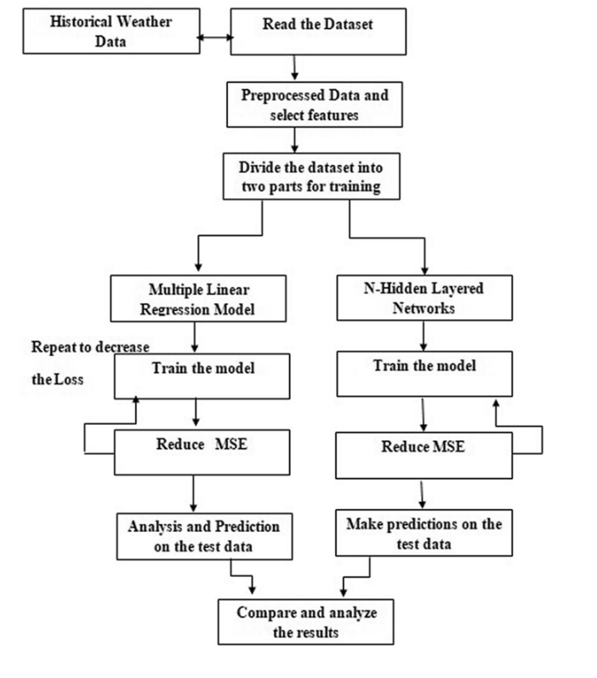
MODELLING
3/21/2024 Annual Review
9

Slide 10
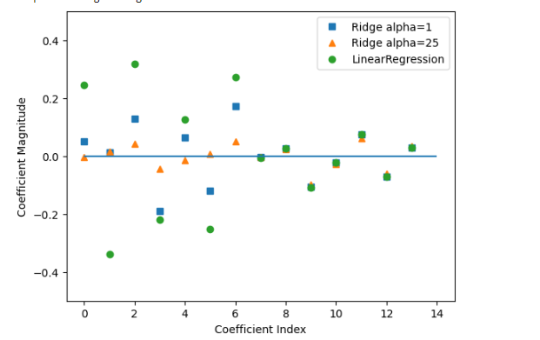
RESULTS
https://github.com/swathy-subbaraman/TNSDC-Generative-AI---RainSense-Advancing-Rainfall-Forecasting-through-ML
3/21/2024 Annual Review
10

